Slide 1
Final Presentation
Team 21 - Caped Crusaders

Slide 2
Agenda
System Context
System Performance
Key Decisions and Tradeoffs
Issues and Challenges
Improvements to the system
Recommendations for future MLIP courses
Notes:
Grading is split evenly between: evenly distributed between context setting, drivers, analysis/tradeoffs/decisions/plans (choose 1), views, and presentation quality (3 points each

Slide 3
System Context
Data Preprocessing: Addressed inconsistencies and missing values with advanced techniques like matrix factorization and nearest neighbors, optimizing for a balance between overfitting and underfitting.
Real-Time Data Integration: Integrated with a Kafka stream for dynamic, real-time data processing, employing robust error handling to manage data anomalies efficiently.
KNN Recommendation Model: Utilized a K nearest neighbors model to recommend movies to users based on movies that users with similar taste in movies preferred

Slide 4

Model Testing
A/B Testing: Utilized A/B testing to measure model performance before full deployment of updated models. Measured model performance using average user ratings.
Version Control: Stored information about model version, data, and user requests in our database for easy restoration or reference to older versions of our model

Slide 5
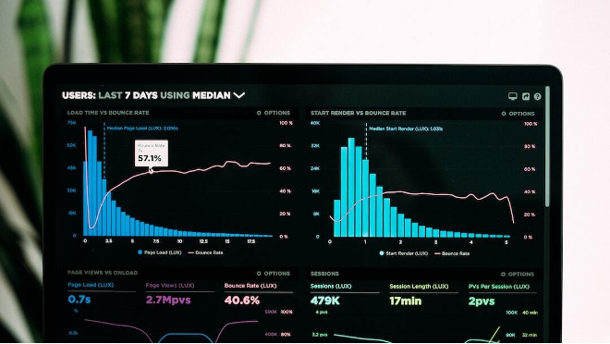
System Performance
Containerization & Deployment: Leveraged Docker for efficient management of dependencies and deployment cycles. Configured Docker Swarm for container orchestration, enhancing deployment capabilities.
Continuous Integration/Deployment: Implemented CI/CD pipelines with Github Actions, automating testing and deployment processes, ensuring stable and reliable builds.
CronJob
Notes:
@Haowen Wu

Slide 6

Security
Security Enhancements: Enhanced security measures to protect against SQL injection and data leaks, safeguarding sensitive user data throughout the deployment.
Security testing: established tests for security and performed post mortem analysis to ensure that security issues did not occur

Slide 7
Key Decisions and Trade-offs
Model Selection: Chose a hybrid recommendation model over singular approaches, balancing accuracy with diversity in recommendations.
Real-Time Integration: Opted for Kafka streaming to ensure dynamic updates, despite complexity, for real-time data processing efficiency.
Architecture Choice: Debated between microservices and monolithic architectures, opting for microservices for scalability despite potential complexity in management.

Slide 8
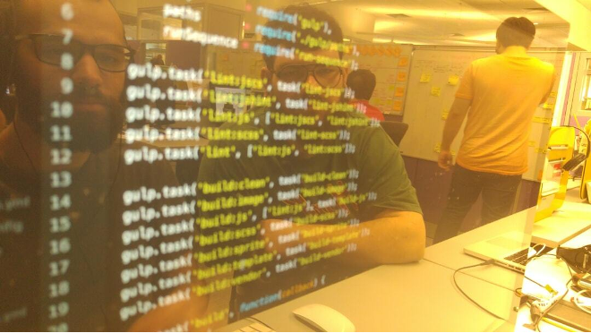
Issues and Challenges
Integration Challenges: Faced significant hurdles in integrating the AI model with Kafka for real-time streaming. Required overlapping skills, causing bottlenecks.
Team Communication: Misunderstandings in task specifications occasionally led to project delays, highlighting the need for more detailed planning discussions.
Conflicts in Design Choices: Experienced conflicts over architectural decisions (microservices vs. monolithic). Resolved by democratic voting, promoting collaborative team environment.

Slide 9
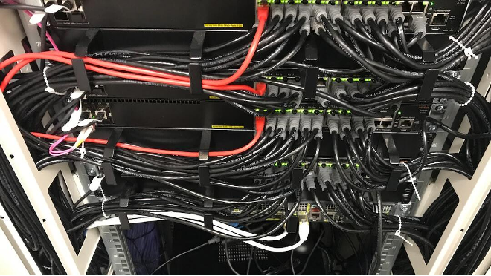
Improvements to the System
Container Management: Improved Docker Swarm configuration for better management of containers, enhancing scalability and deployment efficiency.
CI/CD Optimization: Refined GitHub Actions pipelines to minimize deployment issues, ensuring smoother and more reliable build processes.
Security Protocols: Strengthened security protocols to better safeguard against vulnerabilities, ensuring robust protection of user data.

Slide 10
Recommendations for Future MLIP Courses
Enhanced Cross-Training: Promote cross training among students to handle overlapping skills efficiently, avoiding bottlenecks in project tasks.
Detailed Task Specifications: Implement more detailed task planning and communication strategies to minimize misunderstandings and delays.
Regular Code Integration: Encourage more frequent merges and better branch management practices to reduce issues with code integration and version control.

Slide 11
Thank You!

